Slide 1


Hoạch định nguồn lực doanh nghiệp ERP
Trình bày: GV Đỗ Duy Thanh

Slide 2
Nội dung của phần quy trình trong ERP
Forecast & SOP
Sale & Distribution
Manufacturing
Warehouse & Inventory
Finance in Logistics

Slide 3
Part 1 Basic Concept about Logistics SCM ERP ERP system

Slide 4
Business Operations & Overview

Slide 5
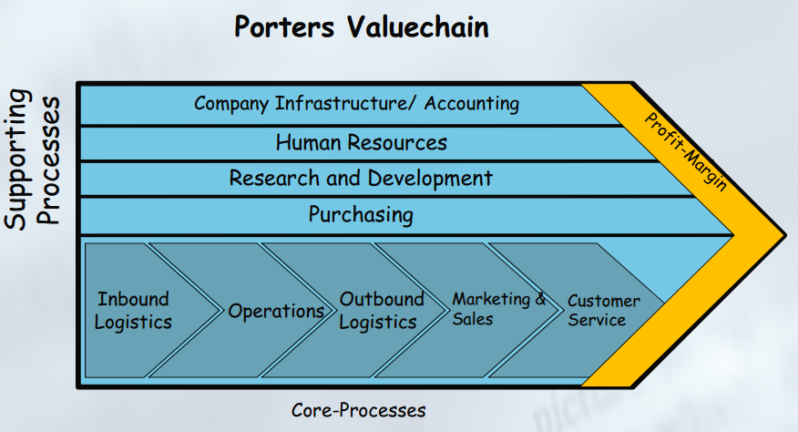
Business Processes

Slide 6
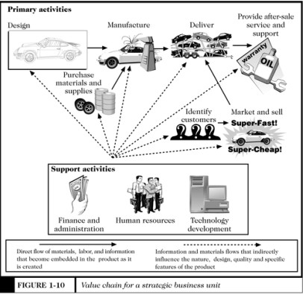
2. Value Chain
Notes:
FI có đóng góp vào chuỗi giá trị không?

Slide 7
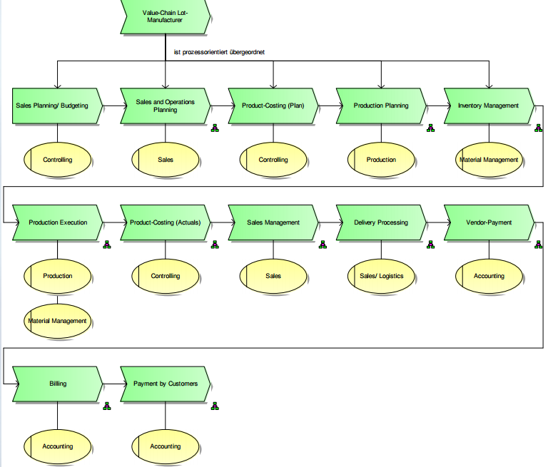

Slide 8
Logistics

Slide 9
Definition of Logisitics
“Logistics is part of the supply chain process that plans, implements, and controls the efficient, effective flow and storage of goods, services, and related information from the point of origin to the point of consumption in order to meet customers’ requirement”
The Council of Logistics Management

Slide 10
Khái niệm (tt)
Logistics là quá trình
tối ưu hóa về vị trí và thời điểm, vận chuyển và dự trữ nguồn tài nguyên
từ điểm đầu tiên của chuỗi cung ứng, qua các khâu sản xuất, phân phối cho đến tay người tiêu dùng cuối cùng
thông qua hàng loạt các hoạt động kinh tế.

Slide 11
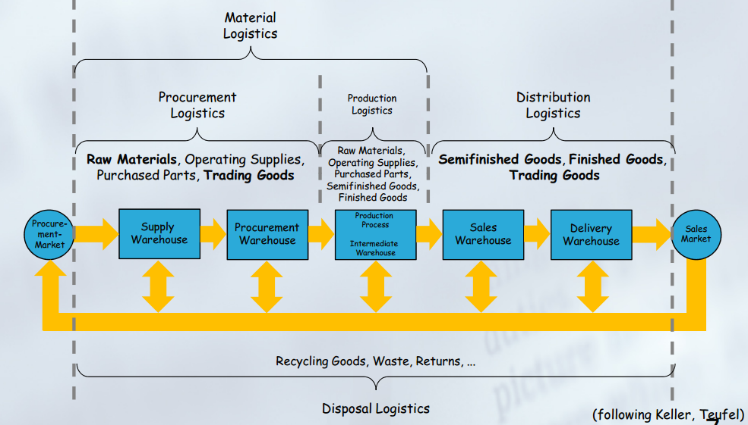
Khái niệm(tt) Product flow in Logistics Company

Slide 12
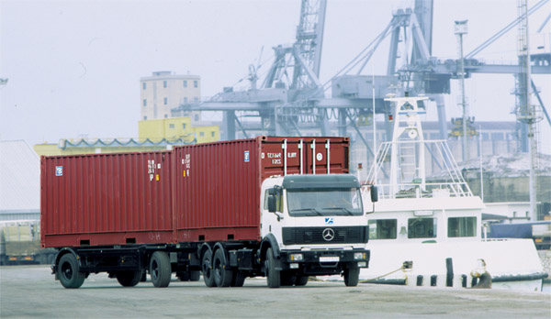
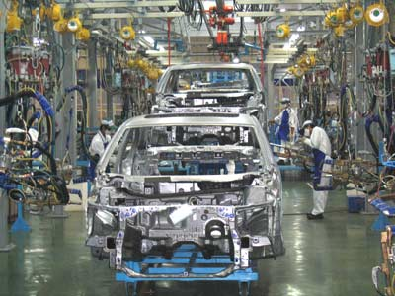

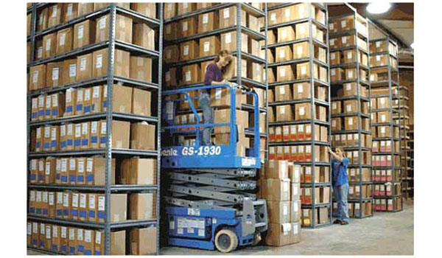
Logistics management
Logistics management solves Optimization in:
Transportation
Manufacturing
Stock
Customer Service
Notes:
Lợi ích của hoạch định

Slide 13
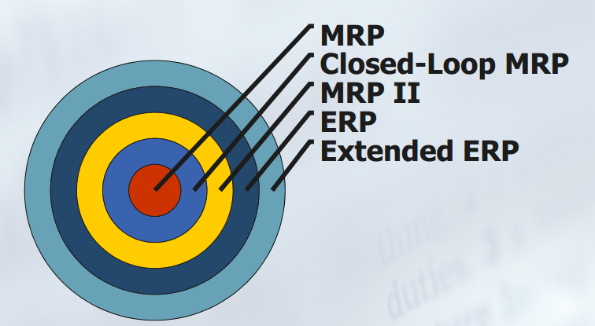
Historical Evolution of ERP

Slide 14
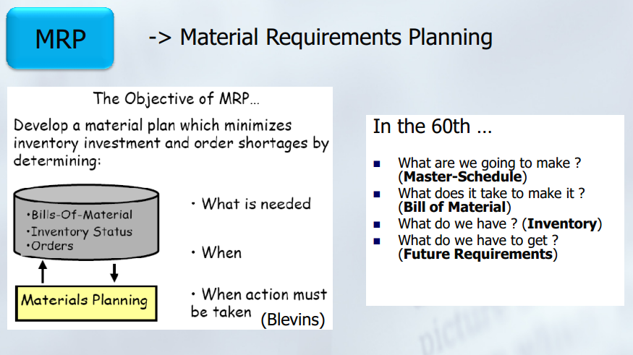
MRP system

Slide 15
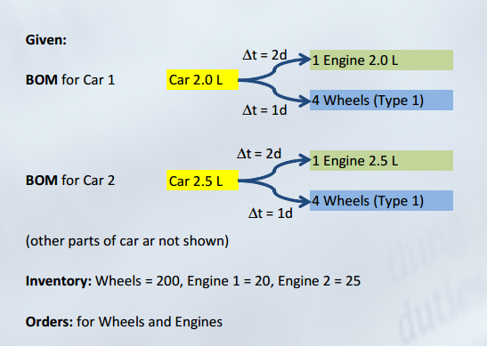
Example

Slide 16
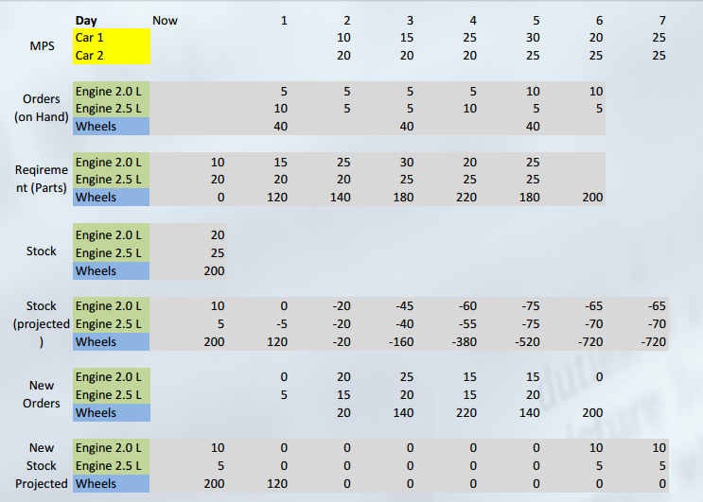
Example: MRP calculation

Slide 17
Disadvantage of MRP
MRP gives us the material requirements & tells us roughly what to do at what time ..
But:
How to deal with order-date-changes ? (Sequence/ Scheduling)
How to deal with the capacity ?(Volume/ Loading)
How to get a valid formal plan ? How to get a valid formal plan ?
How to react on changes in “Real”-Life (Integration with Execution)

Slide 18
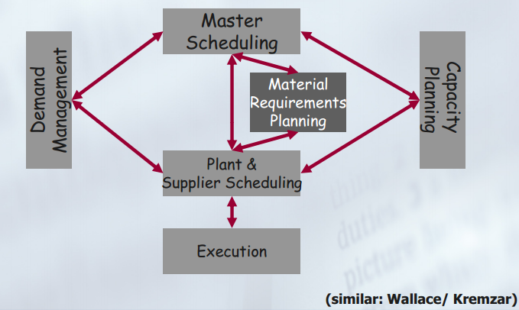
Closed –Loop MRP (functions)

Slide 19
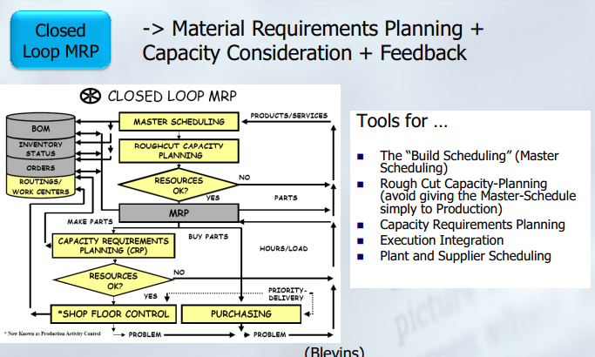
Closed –Loop MRP

Slide 20
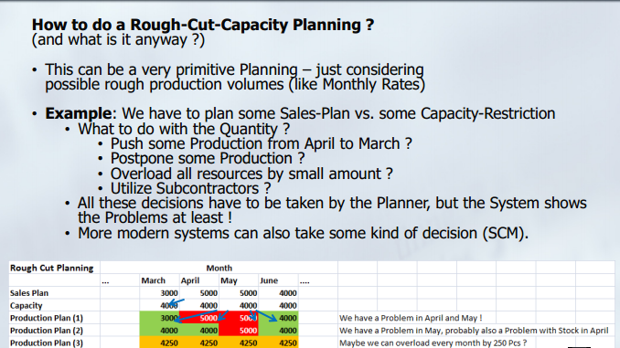
Rough-Cut-Capacity Planning

Slide 21
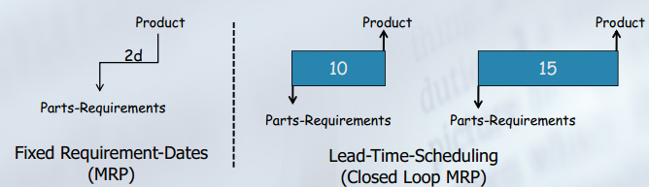
Lead-Time Scheduling
How to do a Lead-Time Scheduling ?
Remember: In MRP, we said that all orders have the same duration – in real live this is not the case.
The order-start and end-dates will always depend onthe order quantity, unless some kind of order-reductions are performed, like Splits.
Lead-Time Scheduling: Calculation of Order-Duration dependent on the Order-Volume.
Needed: Information about the Work -Center-efficiency and about the resource consumption of a specific order -> Routings and Work-Centers are needed in Closed-Loop MRP

Slide 22
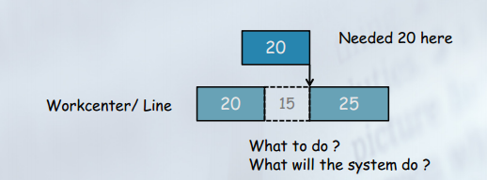
Capacity Consideration
How to Consider the Capacity ?
Remember: We already said, we consider the Rough-Cut Capacity. This is not accurate enough for operative work.
Individual view of capacity of single work-centers is needed.
Basis: Lead-Time Scheduling of individual orders is needed.
Internal Orders -> Lead-Time Scheduling on Work-Centers
External Orders -> Lead- Time Scheduling via Replenishment-Time

Slide 23
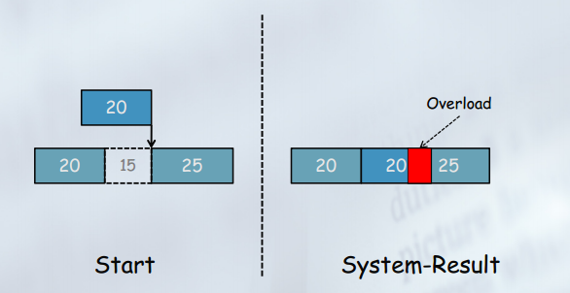
Possible Options for Solution
Several Options how you might react on such a situation
Normally only one Option how a System like this will react

Slide 24
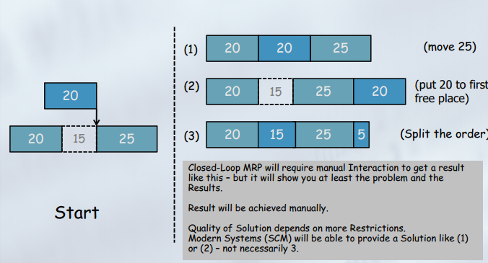
Possible Options for Solution

Slide 25
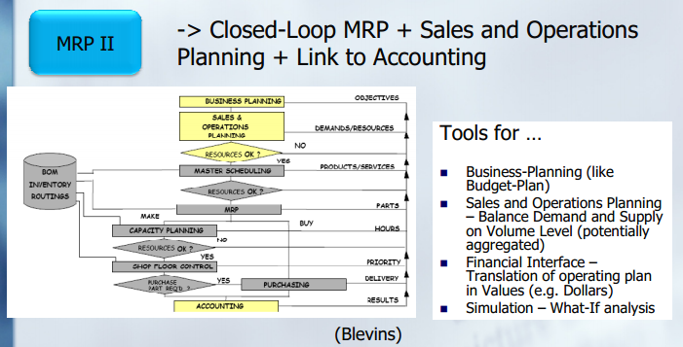
Manufacturing Resource Planning – MRP II

Slide 26
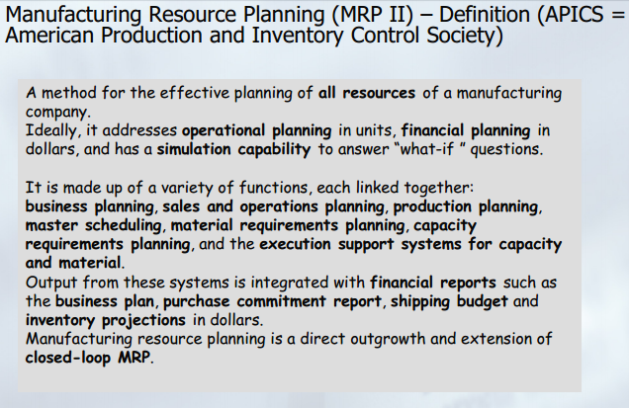
Manufacturing Resource Planning – MRP II

Slide 27
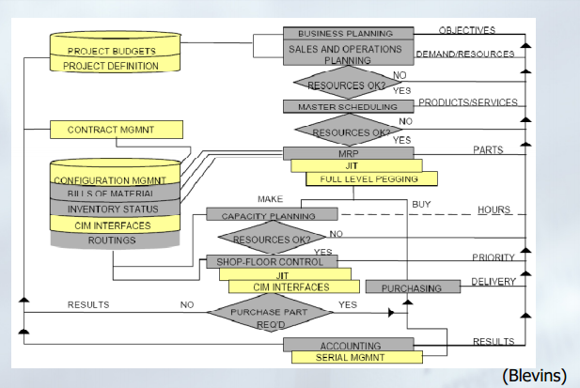
Basic of ERP and ERP system

Slide 28
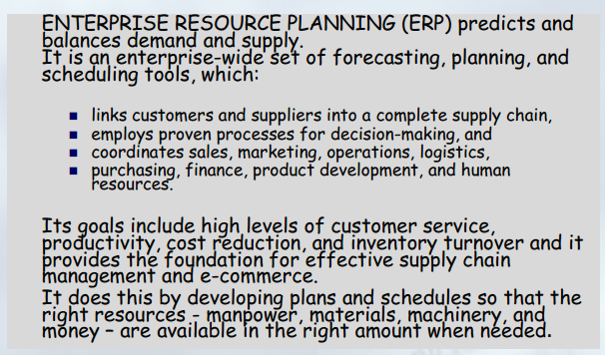
Definition of ERP

Slide 29
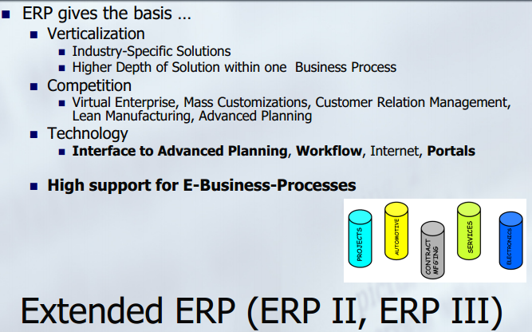
Extended ERP

Slide 30
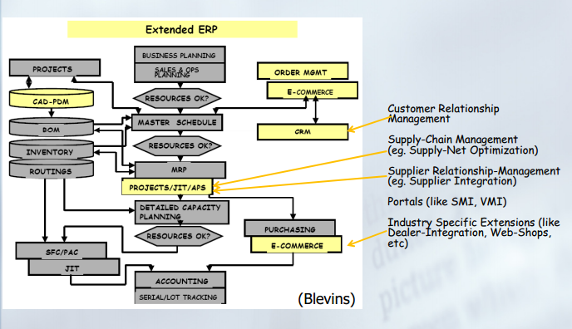
Extended ERP

Slide 31
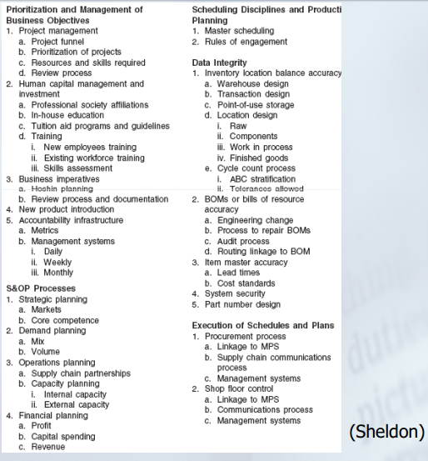
What is supported by a good ERP?

Slide 32
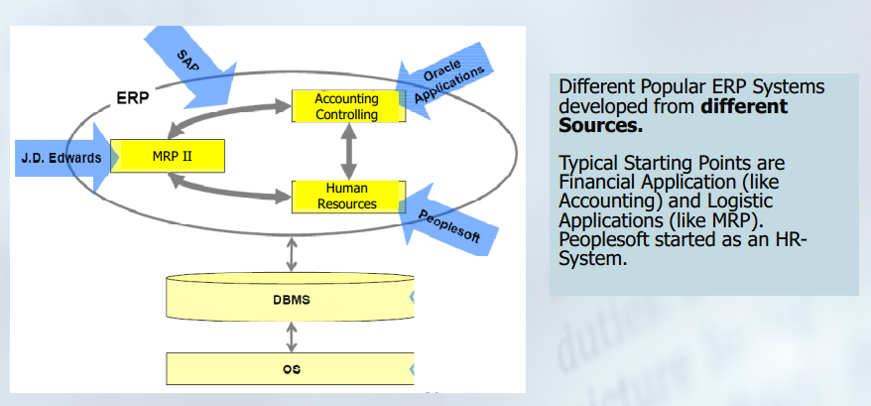
Roots of some ERP systems

Slide 33
Logistics, SCM, ERP
Logistics is a Core processes of Enterprise including Manufacturing, Transportation, Warehouse, Sale…
SCM is a broader concept of Logistics. Logistics indicates only one Business Unit, SMC manages all activities in serial of business Units form Supplier to Customer
ERP system: is a System supporting Enterprise in Planning and Execution the business activities.
SCM system: is a System for Supply Chain and mainly addressing on Planning Activities for Business Chain.

Slide 34
Question?

